Slide 1

Getting Good at Gradle
Bryan Davis
OCLC

Slide 2



Notes:
1. Tech company with a goal of helping libraries work with each other to connect people to the information they need.

Slide 3

Agenda
Basics
Deeper
Good Thoughts
Future
Where to learn more
Notes:
1.Who was at my talk last year?
2.Who here uses gradle?
3.Who would consider themselves PRETTY good at gradle?
4.Who doesn’t really know anything about gradle?
5.Who does not raise their hand when someone asks for a show of hands?

Slide 4

Why Gradle?
We don’t need no stinking builds!
I declare. I don’t impair.
I like to program in XML?
Tell me a dependency management story.
Can I be strong and flexible?
Notes:
1.Builds have traditionally been shunned by developers - That’s changing though.
---With the way modern software development is done, you are forced to face up to building your software
--- Reproducible builds in different environments
---So you need a good tools
2. You want to tell your build WHAT to do. Not HOW to do it right?
--- Declarative vs Imperative.
3. Also, we are developers, we don’t want to program in XML. There are programming languages for a reason
4. Gradle has a better dependency management story than other tools that are out there.
5. Gradle is powerful - but also flexible.
-Builds have been treated historically very superficially... but that is changing in a big way! We need to. CI, Continuous Delivery, DevOps, micro services, multiple projects, reproducible environments, cloud computing..
-declarative / imperative --- executional unit ('Do this' vs ' i have this')
ant only imperitive / maven more declarative but rigid / gradle very declarative but also imperitive when it needs to be
gradle much more declarative build--- i.e. android plugin! - android is much more complex than normal java build - but hidden
Key - ant too low level - maven only project level declarative - gradle can be much more declarative via lower level declarative elements (sweet spot) -.
-Write your build in programming lang, not xml
-Better Dependency Management story (multiple different repo types...
-Flexible Lifecyle - more control over the lifecycle

Slide 5

To get good,
get a solid
understanding
of the basics.
Notes:
1Just like with anything -complex you need a solid foundation of the basic concepts things can get OUT OF CONTROL… quickly
3. SO I am going to run thru real quick what I think the basics would be that you need to understand -
4. That is not the focus of this talk - I basically did not want to start in the deep end of the pool.
Its about having a solid foundation when things get complex.
Important to Not just copy and paste a bunch of things from stack overflow, but understanding the framework and object model and why things are happing
I want to talk about the basics quickly but talk at a little deeper level of what is going on.

Slide 6

A Gradle build file IS a groovy program.
Notes:
1. So in case you did not realize, a gradle build is just a groovy program -
2. did you know you can put any groovy or java code in a build file and it will execute?
3. EXAMPLE
-Gradle build is just a groovy program
-Nice thing about groovy is that you can just run it as a script. (Don’t need to add the class structure, main method stuff. Groovy will assume that )
-Any groovy will work. Any java will work

Slide 7

In fact, Gradle is just
a groovy DSL
optimized for
performing builds
(Don’t forget the Rich object model!)
Notes:
1.Groovy is GREAT at writing a Domain Specific Language
2.The syntatic sugar that Groovy gives you is why it was chosen.
3.A nice and powerful thing about gradle is that the same lower level API that they write the DSL in, is available to you in your build
-Groovy is great for creating DSLs. So that is what they did with Gradle.
-Cool thing is that the Object Model that the GRADLE DSL uses is available to you in your buildscripts and plugins. (Big difference from Maven)
-Use can even use the low level pieces to make a DSL for your own company or problem space. (Like the Android folks did)

Slide 8
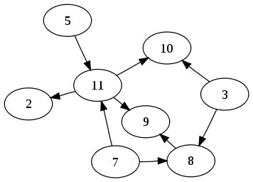

Directed Acyclic Graph of Tasks
Notes:
1.If you want to have a mental picture of a gradle build- you can think of it as a DAG
2.DAG is graph where each node has a defined direction and does not circle back on itself
3.Toolkit for anything that needs automation

Slide 9

Project ⬄build.gradle
Notes:
1.2 basic concepts. - projects and tasks
2.a project loosely represents a thing you are building or a thing you are doing
3.REMEMBER - Each build.gradle file is a separate project object instance.
-projects and tasks. - projects represent something to be built or done and uses tasks to accomplish it
Every build.xml causes a project object to be created. one to one.
Rich API -and it is an Object. You can look at the java doc for it to see what you can do with it

Slide 10
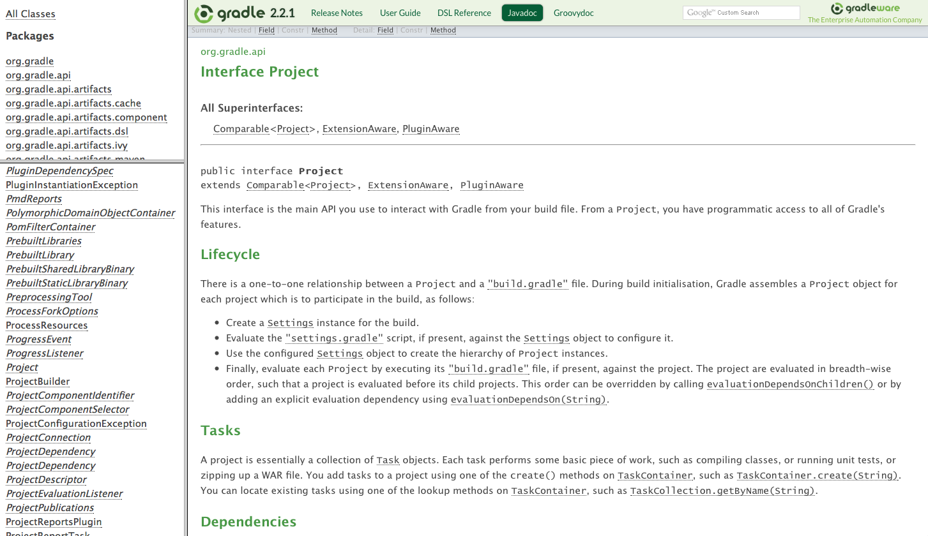
Notes:
1.A project object is a real object
2. This javadoc proves it!

Slide 11
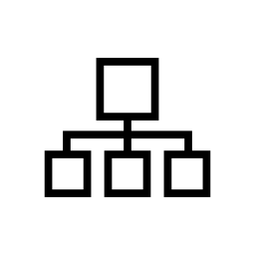
settings.gradle
Notes:
1.Most builds are going to need to do multiple things.
2.the Settlings.gradle ties everything together.
3.But you guys already knew all of this
-Settings file describes project structure – hierarchy of project structure
-each sub project is it’s own project instance
(GradleBuild if you need extra control of heirarchy)

Slide 12

List
Task ⬄ of
Actions
Notes:
1.Your build is going to set up a task graph right?
2.Well what is a task?
3.It’s just a list of actions to be performed
A Task is just an object - like a project is an object
It contains properties and a list of actions - creating a task is just putting actions in the list
It has a Javadoc too

Slide 13
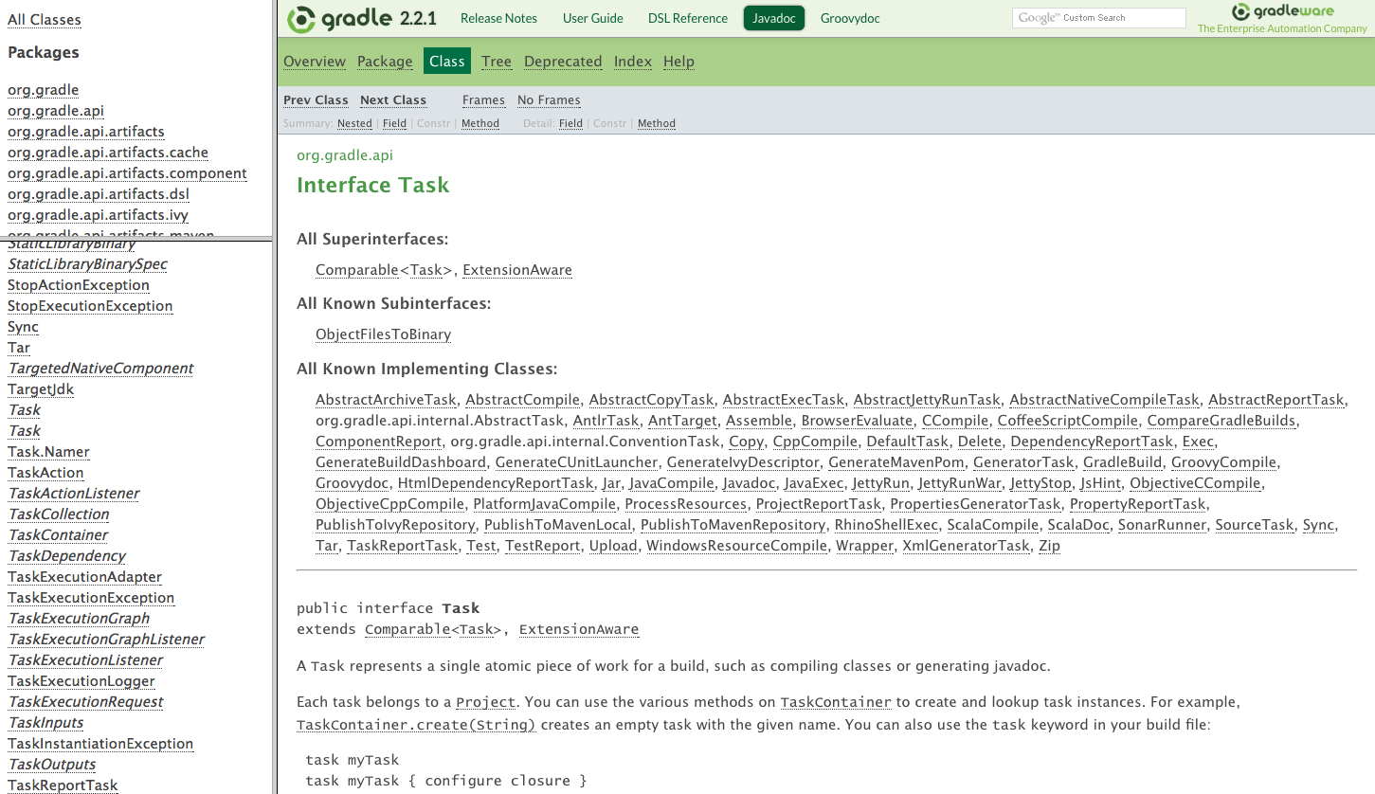
Notes:
See: A Task is a object too… it’s got javadoc… and everything

Slide 14

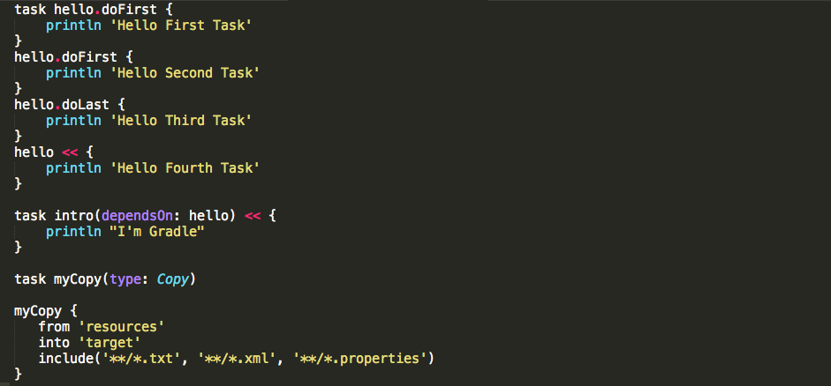
build.gradle
Notes:
Example
1.Add actions to the list
2.create that dependency graph
3.don’t start from scratch
Example of setting up list of tasks
doFirst / doLast - takes a groovy closure - or a method
simple to add a dependency of a task on another
Create a task based on predefined type - then set up its configuration closure

Slide 15

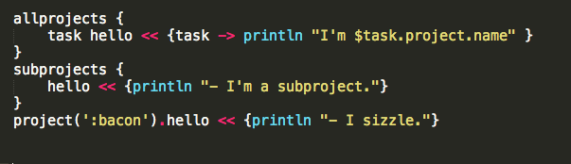
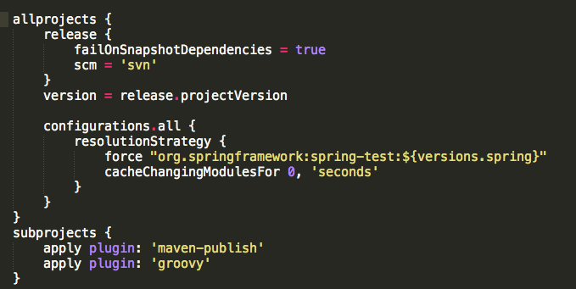
Multi Project DRY
Notes:
1. You guys are good developers and you know REPEATING yourserlf is BAD
2. Gradle offers a lot of techniques to allow DRY - for example configuration injection
In a multi project… don’t repeat your self
Define a common task
Define common configuration

Slide 16

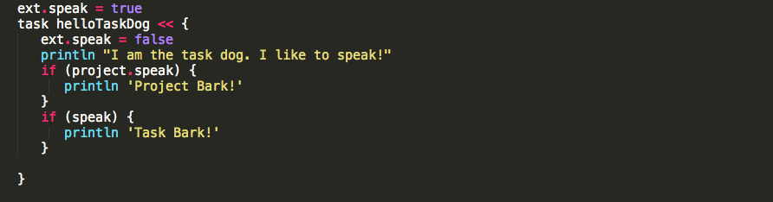
Lets talk properties
build.gradle
gradle.properties
from -Pproperty=x on the command line
from gradle.properties in gradle user home.
from gradle.properties in project build dir.
Notes:
1.Remember that most Gradle core objects are ExtensionAware - So you can add your own custom properties to these objects.
2.This example shows adding a speak property to a project object and task object.
3.Just remember that relative references depend on context.
STORY?
4.Also you can define properties in external properties files.
5.Remember that there is a distinct order that properties are going to be resolved -
-Most core gradle objects are ExtensionAware (ext properties)
- This is how you create a property on your object.
-Don’t need to use it to reference or set
- keep you from fatfinger creating new property
-two properties here. one on project. one on task.
-The other type of properties are external to ext properties. (Treated the same in the project)

Slide 17

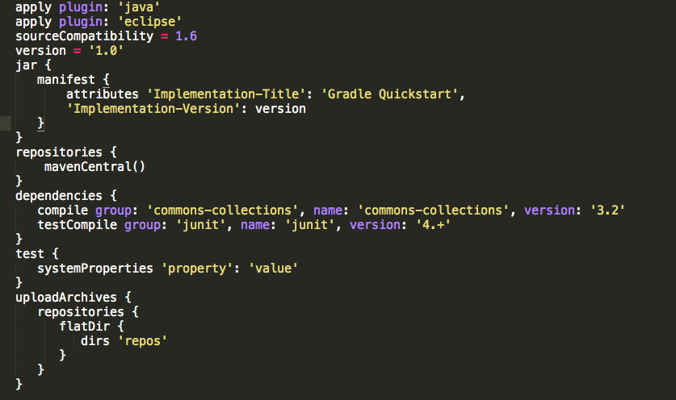
Do what I mean! Plugins and Declarative Builds
Notes:
1. The power in gradle is having a declarative build. - do this with plugins!
2. A build that is readable and maintainable and NOT FRAGILE
3. Describe what you are doing. Not how to do it.
4. Here is an example of a complete java - full lifecycle - notice - does not tell HOW to do anything

Slide 18
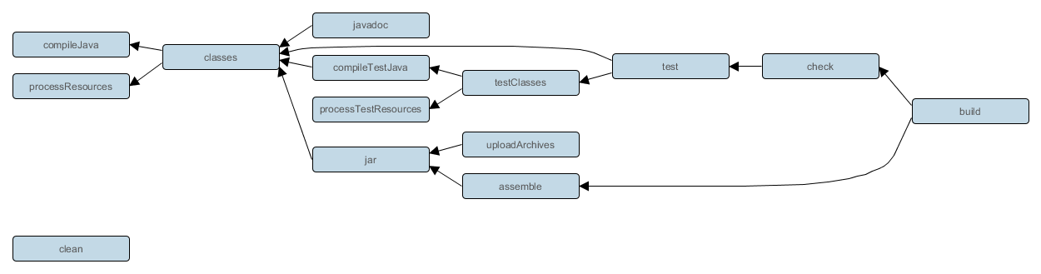
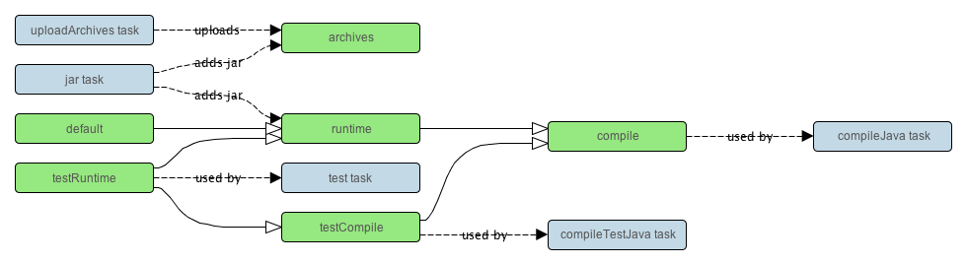
Java plugin task graph
Java plugin configurations graph
Notes:
1.Since we are talking about plugins
2.Plugins will define tasks for you. and how they depend on each other.
3.This is the java example - It defnines a TASK GRAPH of a FULL JAVA LIFECYCLE
4.The will also define configurations for you. which I will talk about in a second
Java plugin - task graph - convention over configuration
-ie: Build will cause check and assemble tasks etc…
-plugins also set up the “Configurations” (aka: Scopes)

Slide 19

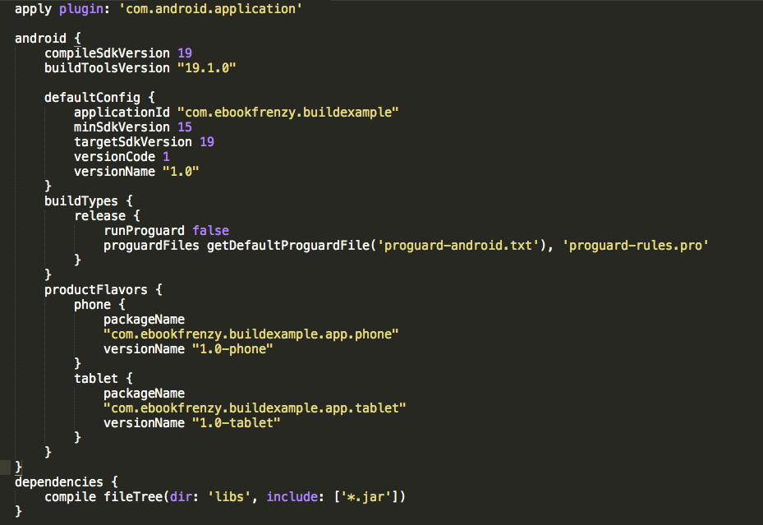
Android Plugin
Notes:
1.the Android plugin is a great example of Building on core Gradle API to develop a new DSL specific to Android
2.Totally Declarative and powerful
3.It was not written by gradle folks
4.Notice it adds new Declarative ELEMENTS ie: build types and product flavors,
5. if not written declaratively - Would have been crazy for developers

Slide 20
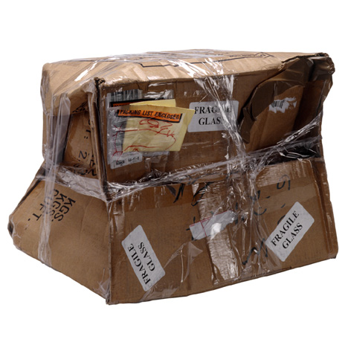
Dependency Management
Where did you get that anyway?
Notes:
1.Dependency management sucks
2.gradle makes it easer
Lets talk about Dependency Management
Get Dependencies
Package Artifacts
Publish Those artifacts

Slide 21
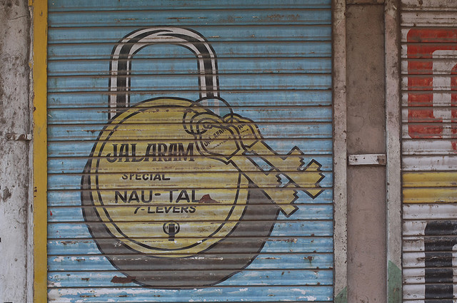
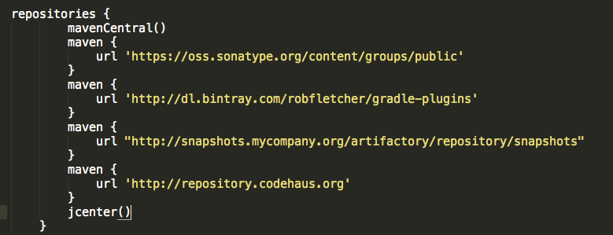
Repositories
Maven
Ivy
File System
Notes:
Easy config that supports different repo types
-So Where to you get your Dependencies and Publish your Artifacts? Repositories
- Gradle supports multiple

Slide 22
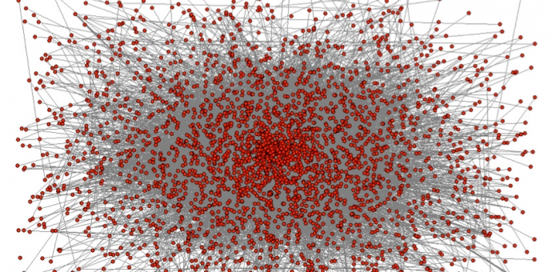
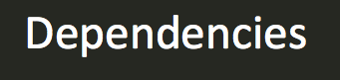
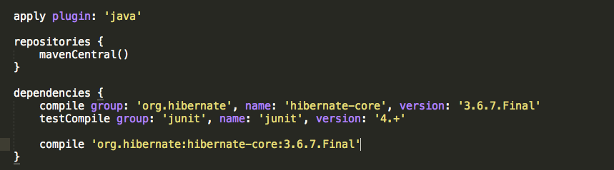
Notes:
1.Easy to specify your dependencies
2.And do it for different configurations
-specify your dependencies with
-Group
-Name
-Version
-Each Configuration (or Scope) has its own sets of dependecies
-Shorthand

Slide 23
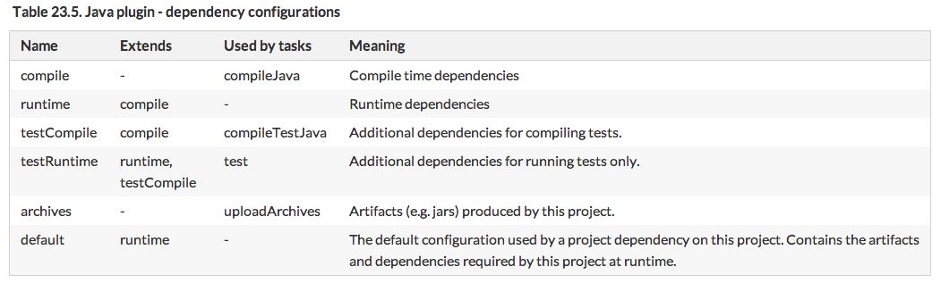
Configurations (aka scopes)
Collection of Dependencies and Artifacts
Defined by Plugins and custom configurations
Notes:
1.when I talk about configurations - what do I mean? You know them as maven scopes.
TWO THINGS TO MENTION -
2. Configurations extend each other
3.AND Collection of DEPENDENCIES AND ARTIFACTS
4.The are defined by plugins - or you can create your own
Lets talk about configrations.
Remember the graph I showed earlier --- they inherit from each other
Anthing in runtime is in compile
used for dependencies and publications
We will show how to create custom one when I get to custom plugin
I will show a custom config in a build script in the next slide
ie: WAR Plugin defines providedCompile, providedRuntime

Slide 24

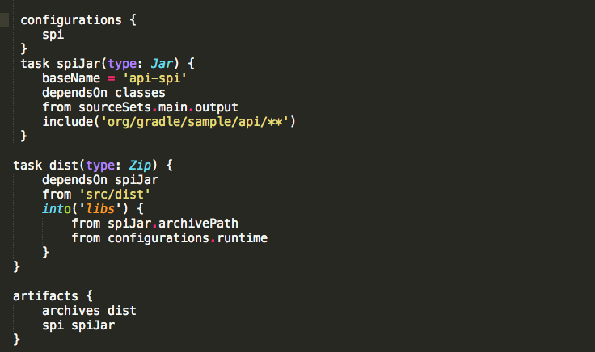
Packaging
Notes:
1. This is an example of creating your own custom configuration so that you can package up an artifact and add it to that configuration
-there is a jar taks is provided as part of the java plugin But if you want to set up your own custom one…
-There is Zip,Tar,Jar,War,Ear are all “Archive” tasks and work the same
-Created a CUSTOM CONFIGURATION and added our artifact to it.

Slide 25

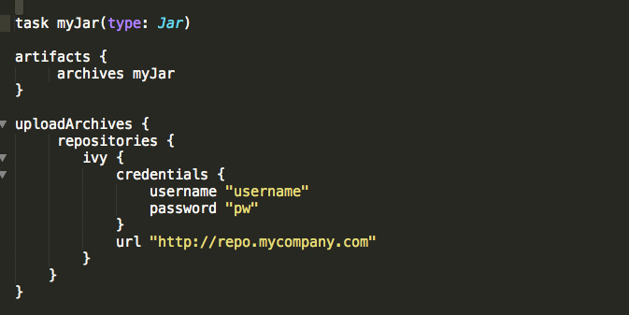
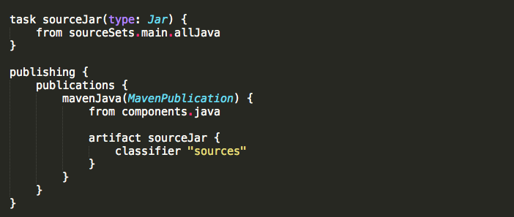
Publishing
“old way”
new maven-publish plugin
Notes:
1. If you started using gradle in the early days, you might not realize that the original way to uploadArchives is no longer the best way to do it.
2. There is a new maven-publish plugin that give you more power and control over what you publish.
3. I will not get into it too much, but make sure you check it out if you are still using the old way
3. It adds a new configuration section here and some powerful defaults to publish your different artifacts.
old way - upload archives task - config repo - publish “artifacts” -- new better config/control
New - plugin adds “Publish Task” and Publishing configurations.
Publishing config == Publications / Repositories
mavenJava == the name of the MavenPublication instance you are setting up
Components is the software component - java is convention/config jar file is published
Standard here with additional sourceJar being published.
Extra artifacts could be added to be published
Repositories block is then set up for where to publish to

Slide 26

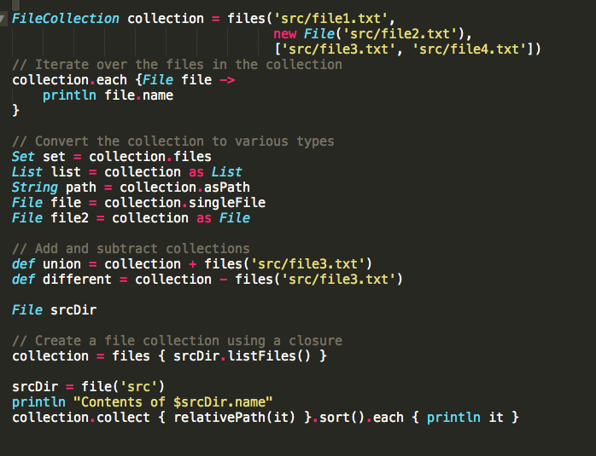
Lazy file collections
File Collection
Notes:
1.When you do a lot with gradle, you will find that you need to do a lot with files.
2.So getting comfortable with file collections is important.
3.REMEMBER File Collections are lazy in gradle. The files don’t need to exist when you create the objects. They are lazily executed when needed.
Collections is where groovy shines. Lets look at am example of working with files
Thing that makes them lazy is that you can set up files, paths, and filters before the files exist they are not executed until they need to.

Slide 27

Lifecycle
Initialization
Configuration
Execution
Notes:
IMPORTANT TO UNDERSTAND
1.Init - Create all of the project instances from looking at the settings.gradle file
2.Config - Execute *all* of the projects involved (Runs everthing that is not part of the task actions) Create Task Graph!
3.Executes the task graph based on what tasks you specified on the command line.

Slide 28

http://www.gradle.org/documentation
Users Guide – High level descriptions / examples
DSL – Full descriptions of the DSL that you interact with in your build script
Java/Groovy Doc – javadoc level guide so you can interact with the objects on a code level
Samples in the Gradle Distro
Android documentation
http://tools.android.com/tech-docs/new-build-system/user-guide
Notes:
Gradle Documentation is excellent

Slide 29
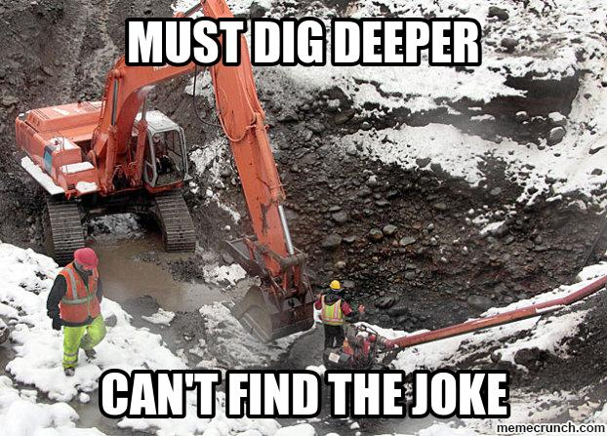
Notes:
1.OK, that is what I would consider the bare minimum of what you need to be able to start getting good!
2.So now lets get good
OK So if you got here you have enough of a basic understanding you should be able to use gradle effectively.
You can leave now.
But there is a lot more in gradle. Let did deeper to get better

Slide 30
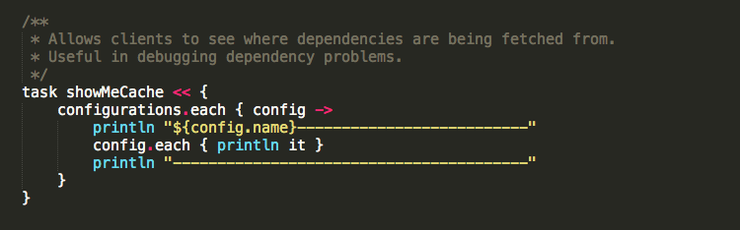
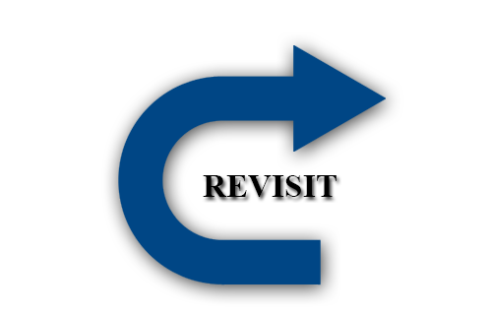
Configurations revisited
Notes:
1.Here is an EXAMPLE of understaing your objects
2.I WANT to know EXACTLY where my dependencies are being fetched from….
3.I know that the project has a “ConfigurationContainer”
4.That container has a list of Configuration objects
5.A Configuration object extends FileCollection (Which is the actual dependencies)
6.I can use the power of GROOVY to print out the actual file name of the file that is going to be on the classpath.
NO DOUBT WHERE A DEPENDENCY IS COMING FROM

Slide 31

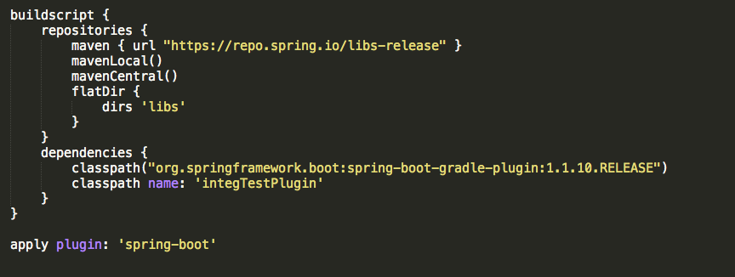
buildscript code block
Notes:
What is the point of the buildscript block? (I have noticed confusion about this so I just want to go over it real quick)
Lets say I want to use a 3rd party plugin… How would gradle know how to use it to set up my project…
KET! This is configuration phase dependencies - not execution phase dependencies!
-BASICALLY IT determines which plugins, task classes are available for use in the rest of the build script

Slide 32

Lets get declarative
Obviously you can do whatever you want- it’s a program
Readable? Reusable? Maintainable?
WAR plugin
Notes:
I will harp on DECLARATIVE BUILDS over and over in this talk for good reason
1. Its too easy to get lazy and just do the exact thing you want imperitively
2.Take the Example of the war plugin
3.You could just create a war task,
War plugin adds tasks, dependencies
new configurations - providedCompile and ProvidedRuntime
4.Using the war plugin you keep you build declarativey instead of telling your build all of these things yourself.

Slide 33
Lets get declarative
How?
Custom declarative elements
buildfile
separate buildfile
drop class in buildsrc
Share! Make it an external dep
Notes:
1.OK. How do we do it?
2.By Writing our own custom declarative elements obviously!
3.I will show how to do this.
4.gradle makes it EASY to do this in a stepwise manner.
GOAL is a buildfile that simply can desciibe your project and say what you want to do /
Not tell HOW to do things.
Custom Task
Custom plugin
You can put the source for the plugin in the rootProjectDir/buildSrc/src/main/groovy directory. Gradle will take care of compiling and testing the plugin and making it available on the classpath of the build script.

Slide 34
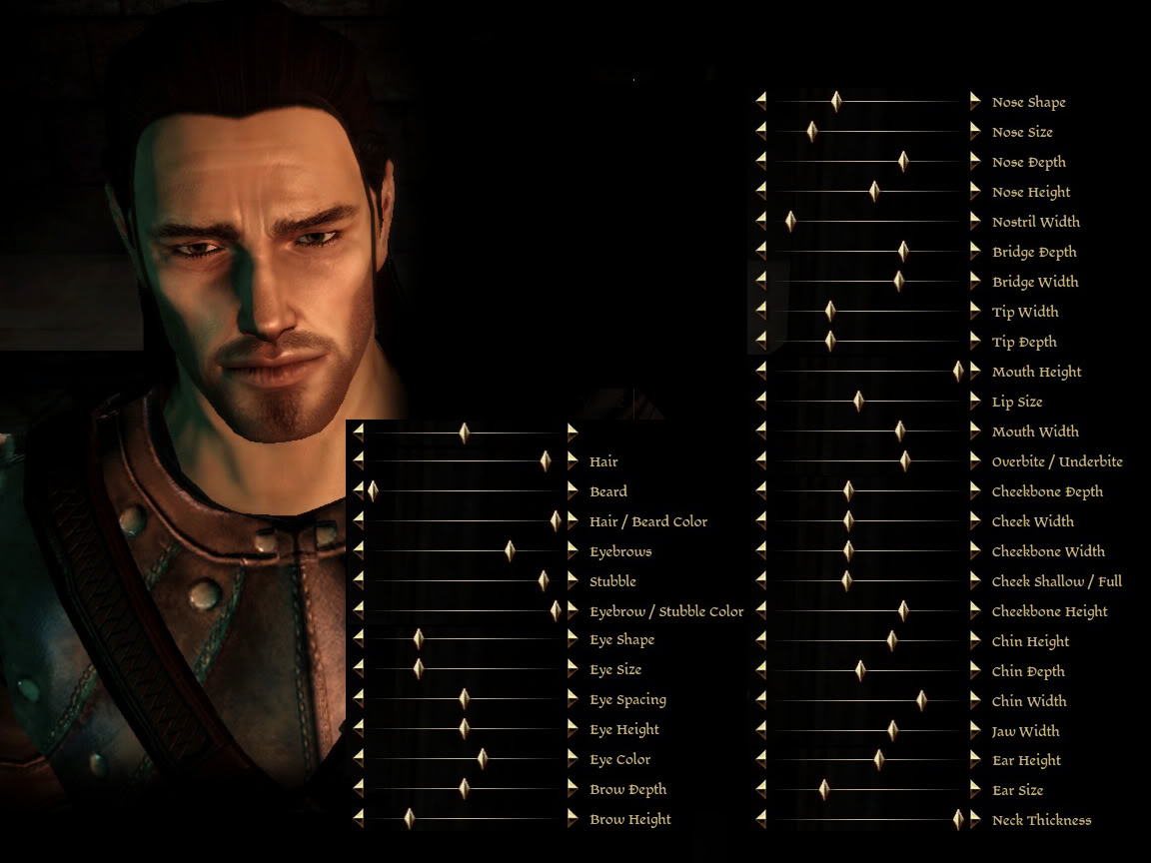
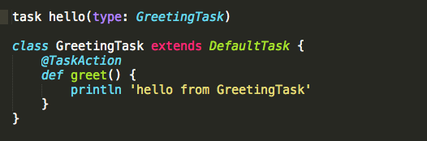
Writing a custom task is simple!
Notes:
This way, we do not have have our actions in the build file.
We don’t have to tell it HOW to do everything

Slide 35

Lets make a plugin

Slide 36

the gradle daemon - our speedy friend
> gradle --daemon
org.gradle.daemon=true
GRADLE_OPTS="-Dorg.gradle.daemon=true"
Notes:
1.Backgroud process that Optimizes speed of running the build
2. DEFINIETELY use in local dev env - . really speed up the (startup and execution time of gradle)
3. The tooling api really makes use of this- for example your IDE can be in communication with the daemon to keep your configuration always up to date so the build can go straight to the execution phase
4. Lots of future improvements are targeting this. Pay attention
5. Here are ways to turn it on

Slide 37

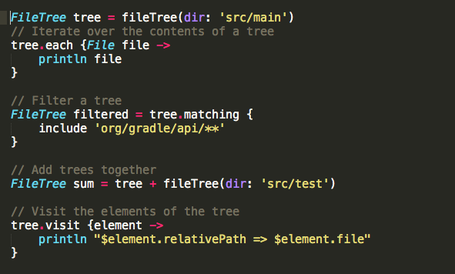
Lazy File collections
File Trees
Notes:
1.I mentioned FileCollections earlier-
2.I feel like it need to mention that there are File Trees as well. They are when you want to keep the heirarchy intact instead of just having a flat list of files
3.There is some additional functionality

Slide 38
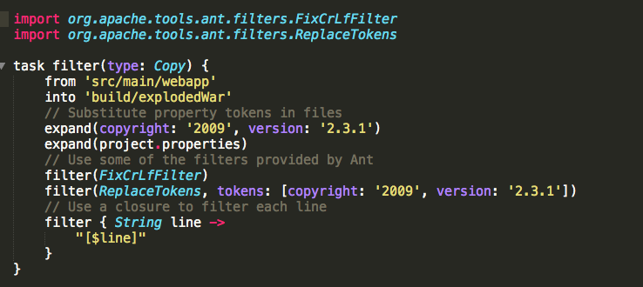

Lazy File Collections
Copy Task
Notes:
1.One thing that is good to know about the copy task is that you do things to the files as they are copied
2.filter - add an ant filter OR a closure
3.expand - expand property references in each file as it is copied.

Slide 39
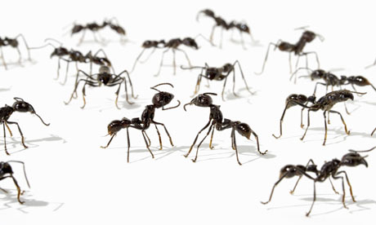
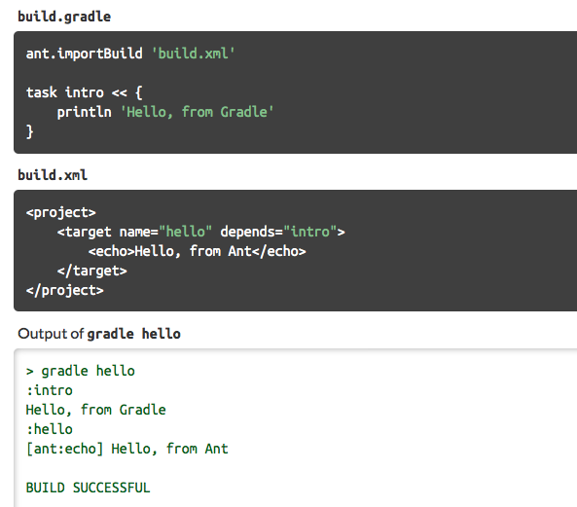
Maven/Ant integration
Notes:
1.ANT is a first class citizen in Gradle
2.If you import an ant build --- it will make your ant targets, gradle task objects.
3.So you can reference one from the other!
4.Some people find it easier to work with their ant files in gradle and import them
You can't use a Maven plugin as-is in Gradle; you'll have to port it to a Gradle plugin. How difficult this is depends on how many Maven APIs the plugin is using. Another strategy might be to call into A Maven goal via Gradle's Exec task.

Slide 40

Cache
Origin aware
Concurrency Safe
Notes:
A couple things to mention about the cache that you might not be aware of
1.The gradle cache is origin aware - So even if a dpenendency has the same corrdinates, if it came from a different repo, then they are treated as different dependecies. -
2.THIS IS TO KEEP GRADLE BUILD AS REPRODUCIBLE AS POSSIBLE
3.Second thing is that the cache is concurrency safe, so you can run multiple builds at the same time as a user on a server
Goal is to make builds reliable – repeatable - independent
Origin aware --- hash code validation - where it comes from, type of repo etc... artifacts from different versions of java possibly,
Not going to work differently if project a puts something in the cache that then is used by project b where if project a had not run then the artifact would be different
Concurrency Safe - so you can run several builds at the same time

Slide 41

The Gradle Wrapper
Always use it!
it’s good control
gradle-wrapper.properties
(http://www.gdub.rocks)
Notes:
1..If not then playing with fire!
2.If not running the build the way that the writer intended then you will get burned.
3.It’s the good kind of control.
4.You can edit the wrapper.properties file to point to your own version of gradle if you need.
---Say your company has certain rules and you want to enforce
---You can bundle init scripts into that version
---You can run your own patched instance of gradle?
5.GDUB.rocks is a little utility you install so you can just type gw and it will run the correct wrapper for the project
SCRIPT that you use - Control the version of gradle that executes the build
- ALWAYS use the wrapper
gradle wrapper task will create this
also gradle init task (types are like maven Archetypes) –
gradle init --type java-library. (scala, groovy, adds plugins) basic is default. Less stuff
Gradle init –type pom (maven conversion)
check wrapper scripts into version control
wrapper can be modified to point to different version of gradle (patched version. Corporate specific stuff)
Can also point to version with init script set up. (Put a file that ends with .gradle in the GRADLE_HOME/init.d/ directory, in the Gradle distribution) more on this in a bit
GDub Example www.gdub.rocks

Slide 42
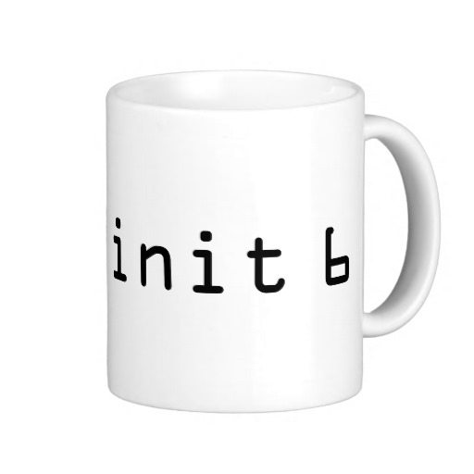
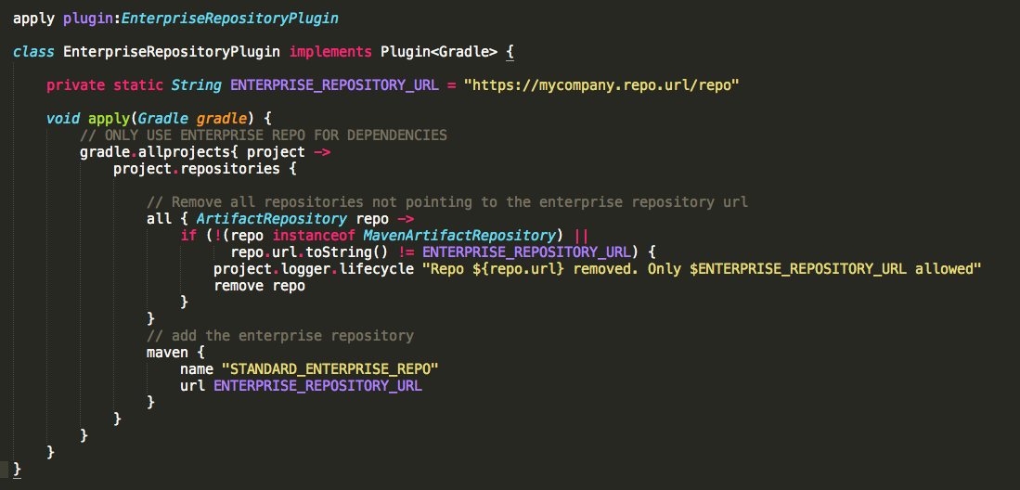
Init Scripts
$USER_HOME/.gradle/init.gradle
$USER_HOME/.gradle/init.d/*.gradle
$GRADLE_HOME/init.d/*.gradle
command line argument
Notes:
1.Init scripts are simply build scripts that run before the build.
2.They can actually do anything that a regular build script or groovy program can do
3.You can use your imagination for what you might need to do before the build start running.
4.Drop them in one of these locations to be executed.
5.This example would be a plugin that will make sure the build script that runs after this one will not pull stuff from a not “enterprise” blessed repository”
facilitate cross project configuration - say you want to customizing the build based on the current environment
look for in
$USER_HOME/.gradle/init.gradle
$User_HOME/.gradle/init.d/*.gradle
$GRADLE_HOME/init.d/*.gradle
or command line arg
load plugins -- happen sooner - bootstraps - early checks in a lifecycle
specify plugin repos
environmental config
register listeners
anything that you can do in a build script
Example (61.3, 61.5 ) -- The plugin in the init script ensures that only a specified repository is used when running the build.

Slide 43

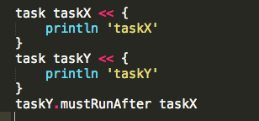
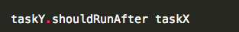
Task ordering
Notes:
1.This is a feature that you might not be aware of…
2.Say you want to make sure one task happens AFTER another task… but you don’t want to explicitly create the dependency on that task.
In some cases it is useful to control the order in which 2 tasks will execute, without introducing an explicit dependency between those tasks. The primary difference between a task ordering and a task dependency is that an ordering rule does not influence which tasks will be executed, only the order in which they will be executed.

Slide 44

Configuration on Demand
org.gradle.configureondemand = true
gradle --configure-on-demand
Notes:
1.This is a new feature in gradle that will try to only configure the projects that are relevant requested tasks instead of the entire set of projects in the build.
2.Try this out and see how well it works for you.
The Configuration injection feature and access to the complete project model are possible because every project is configured before the execution phase. Yet, this approach may not be the most efficient in a very large multi-project build.
Configuration on demand mode attempts to configure only projects that are relevant for requested tasks, i.e. it only executes the build.gradle file of projects that are participating in the build.

Slide 45
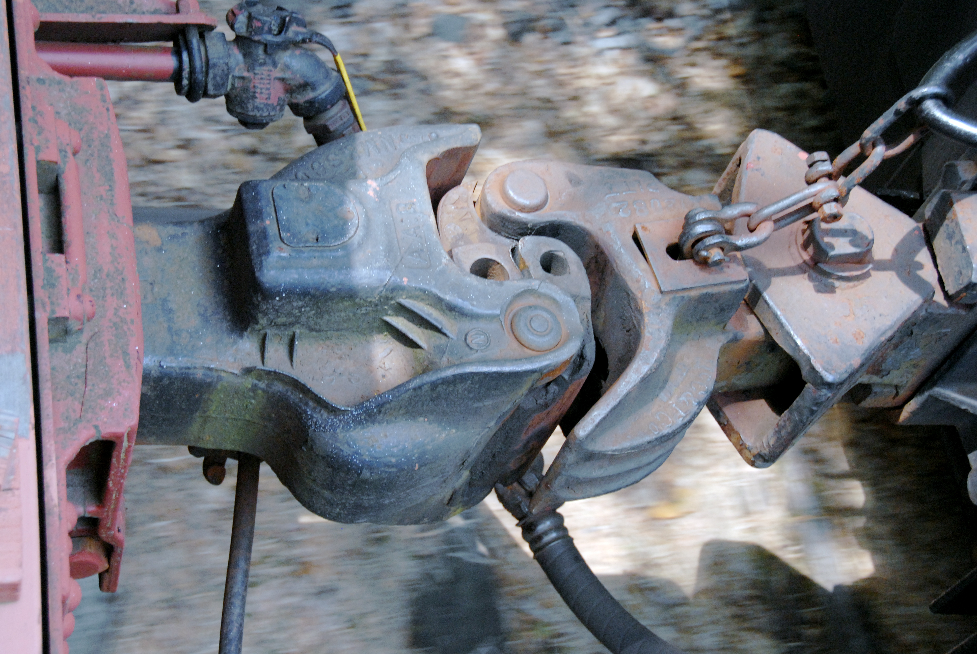
Parallel Builds and decoupled projects
decoupled projects
>gradle --parallel
>gradle --parallel-threads 3
Test.setMaxParallelForks()
Notes:
1.Another new feature is the ability to run gradle in parallel. Meaning that if you have a multi-project build. It can execute those in parallel.
2.A very important PRE-requisite is that the projects need to be decoupled…
3.So what doe that mean?
4.Two projects are said to be decoupled if they do not directly access each other's project model.
5.They can only interact through explicitly declared dependencies.
5a.Any other form of project interaction (i.e. by modifying another project object or by reading a value from another project object) causes the projects to be coupled
6.Gradle does not even attempt to try to figure out all of the ways that you could be modifying the config of the project by accessing something from another project… There are too many ways for this to happen.
7.So it is very powerful and has the potential to really save build time, but you have to be careful.
8.Check out the doc for some guidelines - and try it out!
9.This has nothing to do with running your tests in parallel --- which you should CERTANLY be doing!!! IF not, set that up.
Gradle allows any project to access any other project during both the configuration and execution phases. While this provides a great deal of power and flexibility to the build author, it also limits the flexibility that Gradle has when building those projects. For instance, this effectively prevents Gradle from correctly building multiple projects in parallel, configuring only a subset of projects, or from substituting a pre-built artifact in place of a project dependency.
Two projects are said to be decoupled if they do not directly access each other's project model. Decoupled projects may only interact in terms of declared dependencies: project dependencies (Section 51.4.3, “Project dependencies”) and/or task dependencies (Section 6.5, “Task dependencies”). Any other form of project interaction (i.e. by modifying another project object or by reading a value from another project object) causes the projects to be coupled. The consequence of coupling during the configuration phase is that if gradle is invoked with the 'configuration on demand' option, the result of the build can be flawed in several ways. The consequence of coupling during execution phase is that if gradle is invoked with the parallel option, one project task runs too late to influence a task of a project building in parallel. Gradle does not attempt to detect coupling and warn the user, as there are too many possibilities to introduce coupling.
A very common way for projects to be coupled is by using configuration injection (Section 57.1, “Cross project configuration”). It may not be immediately apparent, but using key Gradle features like the allprojects and subprojects keywords automatically cause your projects to be coupled. This is because these keywords are used in a build.gradle file, which defines a project. Often this is a “root project” that does nothing more than define common configuration, but as far as Gradle is concerned this root project is still a fully-fledged project, and by using allprojects that project is effectively coupled to all other projects. Coupling of the root project to subprojects does not impact 'configuration on demand', but using the allprojects and subprojects in any subproject's build.gradle file will have an impact.
This means that using any form of shared build script logic or configuration injection (allprojects, subprojects, etc.) will cause your projects to be coupled. As we extend the concept of project decoupling and provide features that take advantage of decoupled projects, we will also introduce new features to help you to solve common use cases (like configuration injection) without causing your projects to be coupled.
In order to make good use of cross project configuration without running into issues for parallel and 'configuration on demand' options, follow these recommendations:
Avoid a subproject's build.gradle referencing other subprojects; prefering cross configuration from the root project.
Avoid changing the configuration of other projects at execution time.
Gradle has a feature where it will try to build projects in parallel. (But use this in decoupled project cases)
Parallel is not at the task level though. Only project level.
This is different though than running Tests in parallel.

Slide 46
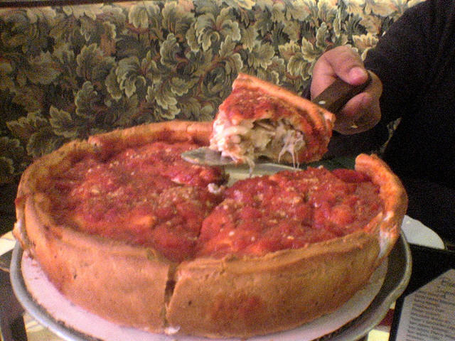
Deeper on Plugins
Notes:
Since Plugins in where we really find the power of gradle lets dig in a bit

Slide 47

Gradle Plugin Portal
http://plugins.gradle.org
Notes:
This is a new community repository for sharing and finding plugins

Slide 48
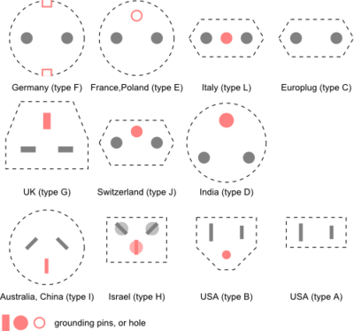
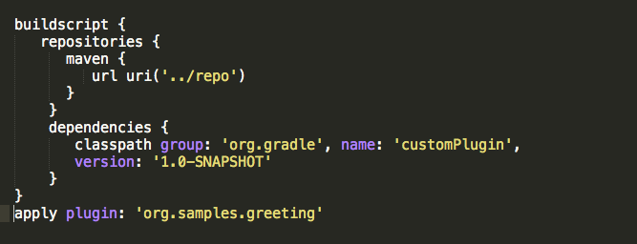
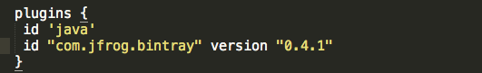
New Plugin Syntax
old
new
Notes:
1. Cool thing is that if you want to use anything in the plugin portal… you have an easy way to do it. Just skip the who buildscript stuff

Slide 49
Plugin plugins plugins…
js – combine, minify, jshint, jsdoc, require.js
plugins {
id "com.eriwen.gradle.js" version "1.12.1"
}
grunt – run our jasmine tests
plugins {
id "com.moowork.grunt" version "0.6"
}
compass – SASS compiler
plugins {
id "com.github.robfletcher.compass" version "2.0.5"
}
Notes:
1. Some of the plugins that we are using that we find useful by the way

Slide 50
Plugin plugins plugins…
Gretty – embedded jetty (*Use instead of gradle jetty plugin)
plugins {
id "org.akhikhl.gretty" version "1.1.8”
}
Cargo – deploy to local and remote containers
plugins {
id "com.bmuschko.cargo" version "2.0.3"
}
SSH - remote command execution and file transfer
plugins {
id "org.hidetake.ssh" version "0.4.6"
}
Notes:
A few other plugings you should know about as well

Slide 51

Netflix Build Language (NEBULA)
Core plugins
Opinionated plugins
http://plugins.gradle.org/search?term=nebula
http://github.com/netflix
Notes:
1.So netflix is a leader in this space
2.They are big champions of sharing their work
3.They developed a ton of plugins to help them with their large code base and projects.
4.There are a number of core plugins that help you do common things.
5. Opinionated plugins - If you want to set up your project like they do theirs, then there are a lot of plugins to do things that they think are great for them, but they admit, might not be for everyone.

Slide 52

“Good Thoughts”
Notes:
Now is the part of the talk where I talk about some of the stuff I have learned over the last year of messing with gradle
And the things that are approved by Brent Rambo --- kind of like his new Machintosh computer.

Slide 53
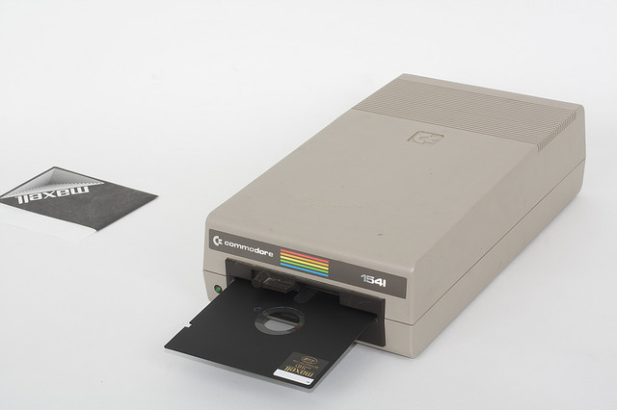
Treat your build like a piece of software
Notes:
Gradle build is software, so you should treat it with the same care as your code.
-Maintain it! Refactor it! Keep it clean!
Keep it readable.
Code reviews.

Slide 54

It’s better to have more smaller projects
Notes:
1.Noone wants to make one minor change and have to run the entire 30 minute build…
.if you have small subprojects…
2.Your local build is faster. (Does not have to rebuild other projects)
3.You don’t have so many other people breaking your build

Slide 55

stack
your
plugins
Notes:
1.I have seen some nasty looking plugins - where you thought, what this a developer that wrote this?
2.Follow the model that the gradle core plugins adopt.
3.Just like code. Build upon lower levels.. Share. Use Higher abstractions
4.Base Plugin - defines a basic project lifecycle and some common convention properties
5.Java Base Plugin - basic java project lifecycle
6.Java Plugin - full java project lifecycle tasks and configurations

Slide 56
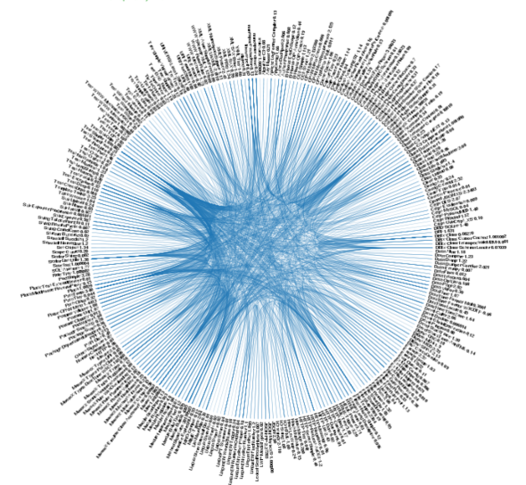
Dependency Management Revisited
Version your Jars.
Manage your transitive dependencies
Deal with version conflicts
Dynamic Versions / Changing Modules
DRY dependencies
Notes:
1.Pet Peeeve - If you are not in the habit of putting versions in the filenames of your jars, then get in the habit. noone wants to look at a project and not know what versions the dependencies are
2. Its amazing how many folks still manage transitive dependencies themselves.
- use an XML descriptor file like a POM
- Gradle makes it so easy to do
3. Make sure you pay attention to your transitive dependencies. Know what they are. Know when there are conflicts
- Gradle makes this easier with the dependency tasks that are built in Like Dependency Insight
- USE THE TOOLS
- Deal with conflicts sooner rather than later
use your gradle dependency task to know your transitive dependencies and use resolution strategies and excludes to deal with problems sooner -- talk about these next as well as the last two

Slide 57

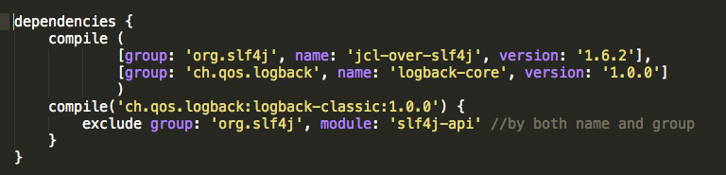
Exclude transitive dependencies you do not want
Notes:
1. It’s really easy to exclude dependencies you don’t want.

Slide 58
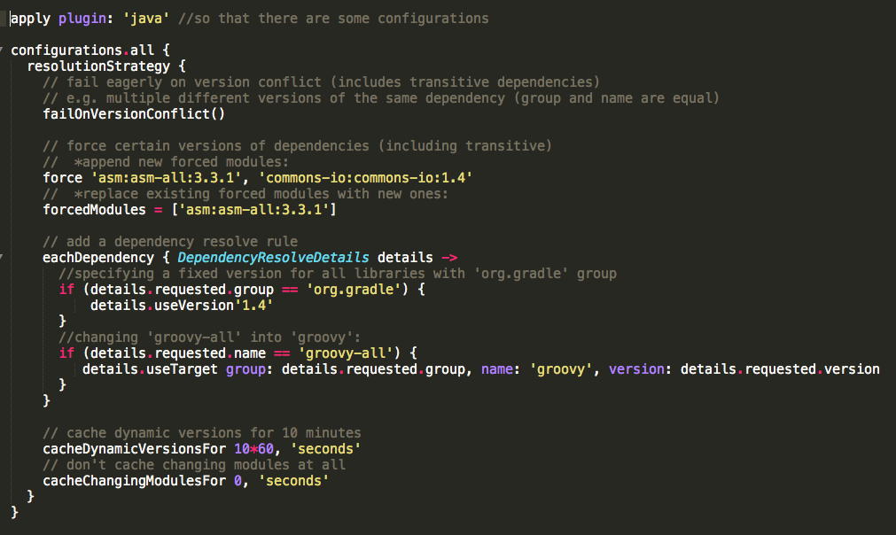

Understand ResolutionStrategy
Notes:
1.BUT TO GET GOOD- And For more power… UNDERSTAND your Resolution Strategy
2. All configurations have a “ResolutionStrategy” to help deal with this
3. There are a lot of things you can do.
4. For example you can have the build fail if there is a version conflict
5. You can force your build to use a specific dependency
6. Or when you see a certain dependency, you can replace it with one you want
Newest: The newest version of the dependency is used. This is Gradle's default strategy, and is often an appropriate choice as long as versions are backwards-compatible.
Fail: A version conflict results in a build failure. This strategy requires all version conflicts to be resolved explicitly in the build script. See ResolutionStrategy for details on how to explicitly choose a particular version.
Configuring a first level dependency as forced. This approach is useful if the dependency in conflict is already a first level dependency. See examples in DependencyHandler.

Slide 59

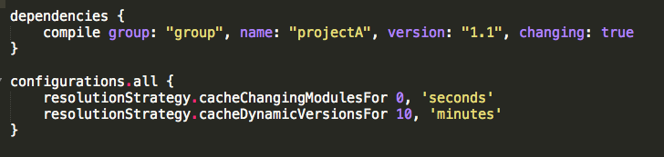
Dynamic and Changing Versions
>gradle --refresh-dependencies
(default 24 hours)
Notes:
One thing I want to mention because this has caused me headaches- if you have a changing module --- one that changes but essentially has the same coordinates. (Like -SNAPSHOT) you need to mark it as changing in the dependency config
Then you can set up how long it will be cached for. (Same thing for Dynamic versions by the way

Slide 60
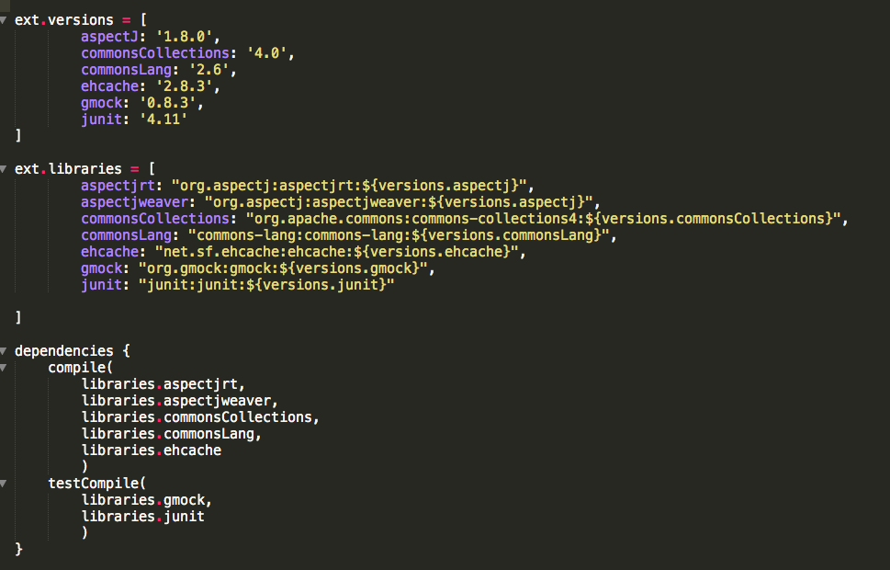
DRY dependencies
Notes:
1. Keeping versions in sync was a problem for us in some larger multi project builds. So we found a way to share the configuration.
2. We used the project external properties to define a property for each dependency
3. So all projects that wanted a dependency could just say “I want commonsCollections” and all get the same version.
1. If you have multiple projects that might have some dependencies in common, a good strategy that we have found is to set up properties in the root project that fully specify the dependency and its version. Then anyone in a later project can just say they want it and it will be the same dependency

Slide 61

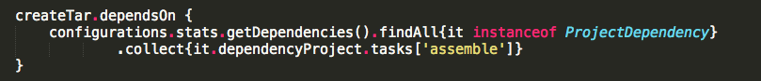
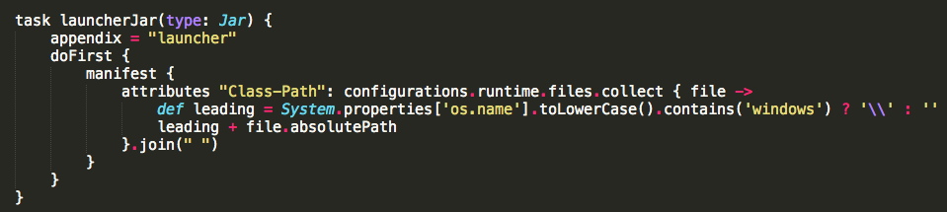
Use the power of groovy
Notes:
Dealing with collections of things is what groovy does very well.
Learn groovy if you don’t know it. There are so many things that groovy will be able to help you do quickly and easily.
*** 1st - Makes sure that all of the “assemble” tasks in the project have run before we create our TAR file
*** 2nd: Setting classpath attribute in our manafest file - get all the runtime dependencies and separate them by a space. - do windows stuff differently

Slide 62


Consider ‘Helper’ methods to be more maintainable and more declarative
Notes:
This is just Good coding practice
More readable
More maintainable
What am I trying to do here? I simply want to apply the groovy plugin to all of the projects that have groovy in them.

Slide 63

Don’t go “Ant”
Don’t code by “SOCP”
Notes:
I know when I used to write ant build scripts, I ended up with a junk drawer of a build file…
You *could* get lazy and end up with the same thing in gradle.!
DON’T - instead keep your Declarative build.

Slide 64

Fail Fast
Notes:
Who has run a build and after 20 minutes it failed because you forgot to specify maybe an environment variable? It got through all this stuff and failed when it tied to use it?
DON’T do that! IF it is something you know in the configuration phase? Validate there!
If you have a task that requires something to be set up… You can validate that in the “Configuration phase” of the project… don’t wait until the execution of the build fails after 20 minutes…

Slide 65


Understand your Gradle Objects
Notes:
1.Once you just get something to work. Don’t stop there. make sure you understand the objects you have.
2.There are a lot of things you can do with these objects that might save you a ton of time later.
3.Understand your objects
Reminder! Look at the docs. Understand your objects. There is a lot that you can do in a build.
Cconfiguration is an instance of FileCollection but understand that there are other properties you can use.

Slide 66

Optimize builds for
Smaller Projects
Decoupled projects
Parallelism
profile
keep up
Notes:
I know it sucks writing your build sometimes… but how many folks are going to be running your build? How many times is it going to execute? IF you can spend a couple of hours to optimize your build, think of all of the hours you can save your team In the long run?>

Slide 67

Understanding Your Project
> gradle projects
> gradle tasks --all
> gradle dependencies
> gradle api:dependencies --configuration testCompile
> gradle webapp:dependencyInsight --dependency groovy
> gradle properties
> gradle --profile
apply plugin: ‘project-report’
apply plugin: ‘sonar-runner’
Notes:
1. Gradle has a lot of tools to help you make sense of your project.
2. project runner plugin will produce a nice html report of the output of a lot of the above tasks
3. sonar-runner will produce a report of the “static-analysis” tools you might have in your build.( Like PMD, Findbugs, checkstyle)

Slide 68

More command line-isms
> gradle dist -x test
> gradle --rerun-tasks
CamelCase tasks
> gradle -q
> gradle --dry-run
Notes:
-x exclude tasks
gradle MRDTN (My Really Descriptive Task Name)

Slide 69

Gradle in the Future
http://gradle.org/roadmap
configuration model
parallelism model
dependency management variants
tooling api
native support
caching
daemon
plugin ecosystem
extensibility
truly distributed build system
Notes:
-new config model goal -> 0 config time (background daemon) - or possibly going away with the config phase altogether
-paralell is where they want to improve speed. - paralel at the task level
-more varianets - ie: 32 vs 64 bit - different java versions…
-imrpove tooling support!
-c/c++
-caching - cache across projects - across servers
-daemon - running all of the time - prefetch stuff to speed things up
-better / more plugins
-extensibe - android plugin extending gradle / android clould test providers extend those plugins / companies using these are then using their own
-not just on a single node

Slide 70

http://www.gradleware.com/conferences/video-android039s-new-gradle-based-build-tool/
http://www.gradleware.com/android/gradle-summit-2014-video-android-development-gradle/
Notes:
If you do android development --- check out these talks

Slide 71

Tooling
http://www.gradleware.com/conferences/video-tutorial-gradle-in-the-developer-tooling-ecosystem
Notes:
If you provide tooling - check out this talk

Slide 72

Build Pipeline with Gradle
http://www.infoq.com/presentations/cd-gradle-jenkins
http://www.gradleware.com/video/web-application-deployments-gradle/
Notes:
If you are interested in Continuous Delivery - check out these presentations

Slide 73



Resources
https://www.gradle.org/learn
http://gradle.org/documentation
http://fourms.gradle.org
http://www.gradleware.com/video/
http://www.gradle.org/books
http://tools.android.com/tech-docs/new-build-system/user-guide
Notes:
Here are some good resources to learn more

Slide 74




